Slide 1


Writing Cypress Test Cases​

Slide 2
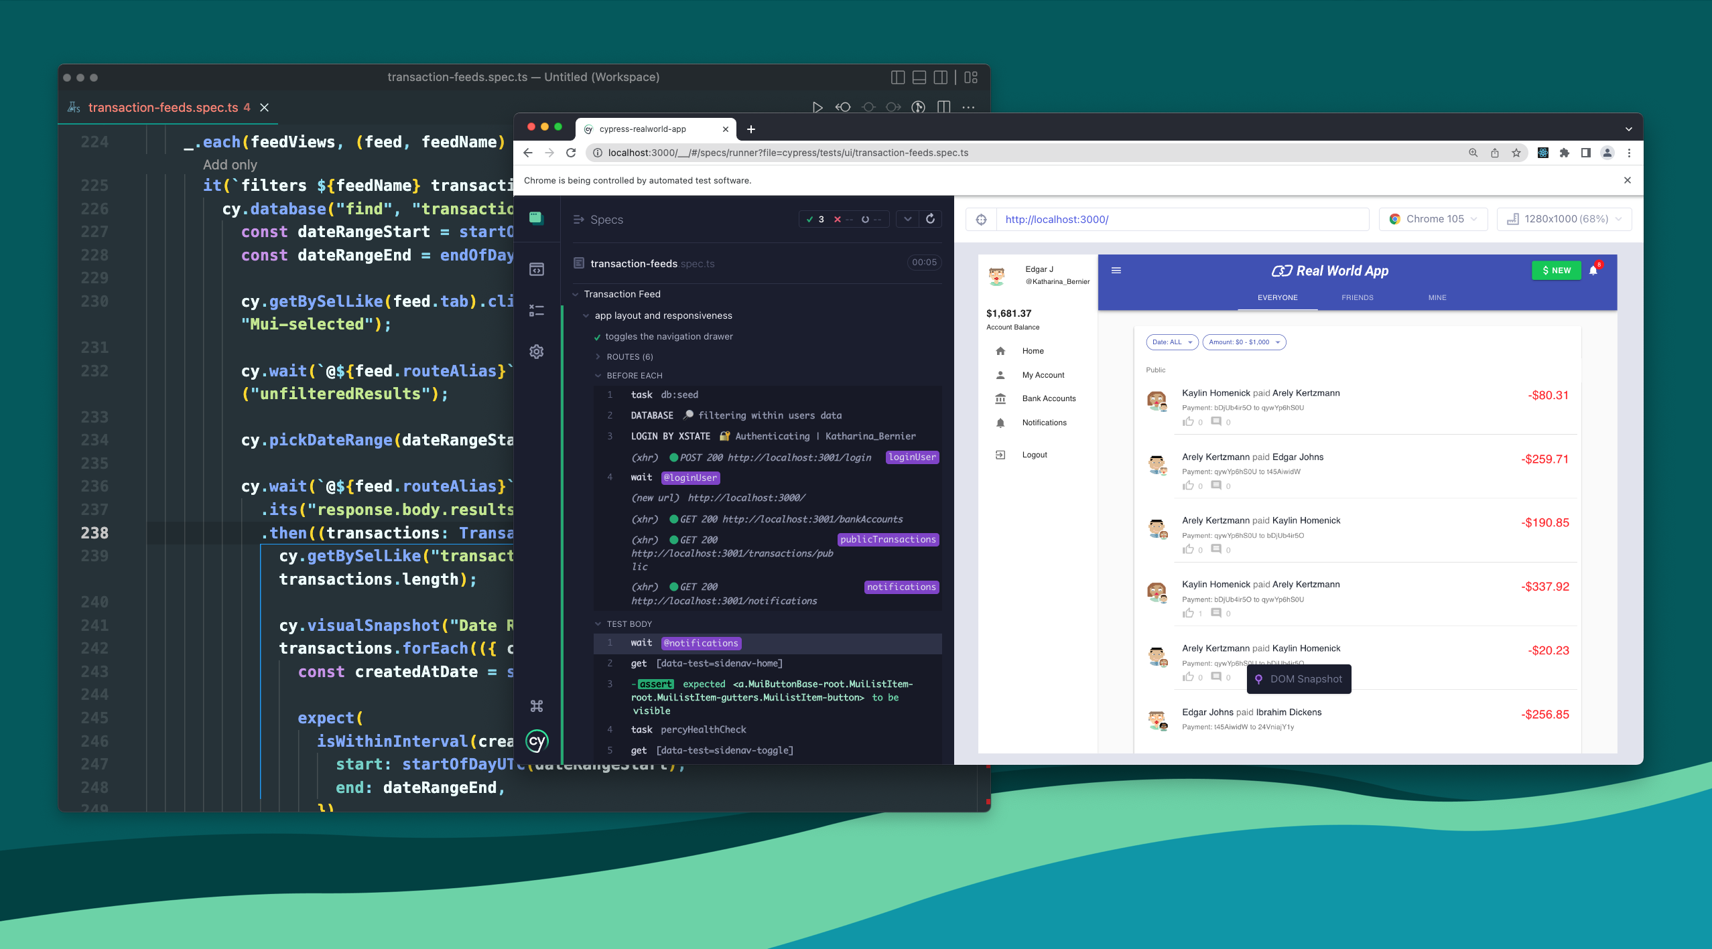
Topics are going to Discuss
Introduction to Mocha and Chai
Writing Basic Test Cases using describe, it
Notes:
In this chapter, we are going to cover the following topics:
Overview of Cypress Architecture
How Cypress interacts with browsers
Cypress Test Runner
Test Execution Life Cycle

Slide 3
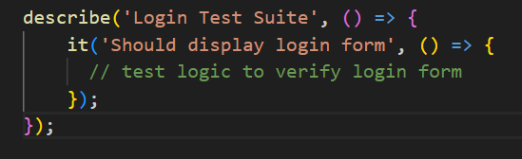
Introduction to Mocha and Chai
What is Mocha?
Mocha is a popular JavaScript test framework used to write and organize tests in Cypress.
It provides a structured and readable way to create tests through features like test suites and test cases.
Mocha Syntax Examples
Key Features of Mocha:
Simple syntax for test suites (describe) and test cases (it).
Clean and hierarchical reporting of test results.
Easy integration with Cypress for automated browser testing
Notes:
Let’s Understanding Test Runner Interface
Cypress Test Runner is a GUI for visualizing and debugging tests. It features a dashboard listing tests, a test runner window showing commands and results, and a browser window displaying the application being tested.
Besides running tests, it includes tools for debugging and troubleshooting, such as a console for logging messages and interacting with the application in real-time, and a network tab for monitoring HTTP requests and responses.
By providing real-time insights into the application's behavior and execution process, it helps QA and developers promptly identify and resolve issues. The interactive interface allows interaction with the application under test and validation of test results.
Key Features of Cypress Test Runner
The Cypress test runner provides a number of features that make it an ideal choice for end-to-end testing.
Interactive Test Execution: Cypress test runner provides a graphical interface that allows you to interact with tests in real time. This means that you can see the application being tested and interact with it while the test is running.
Debugging: Cypress test runner allows you to set breakpoints, pause and inspect code during test execution. This makes it easier to identify and fix issues in the code.
Time Travel: Cypress test runner provides a time-travel feature that allows you to go back and forth between the different states of the application being tested. This makes it easier to debug and understand the behavior of the application.
Rerun Test: You can rerun the Cypress test directly from the Test Runner screen, which reduces the amount of time, going back to IDE and starting the test execution.
Real-Time Feedback: Cypress test runner provides real-time feedback on test results, which allows you to quickly identify issues and fix them.

Slide 4
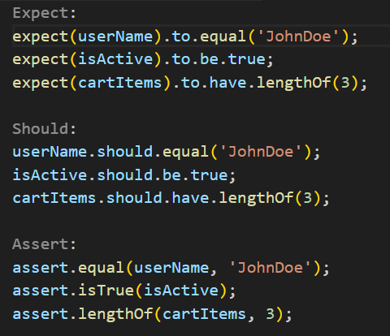
Introduction to Mocha and Chai
What is Chai?
Chai is an assertion library that complements Mocha by providing expressive and readable assertions.
Assertions are checks or validations within tests to confirm application behavior.
Assertion Styles in Chai :
Expect: Natural language style, highly expressive.
Should: Also, natural language, enhances readability (similar to expect).
Assert: Classical assertion style, familiar to developers from other languages.
Chai Syntax Examples:
Notes:
Let’s Understanding Test Runner Interface
Cypress Test Runner is a GUI for visualizing and debugging tests. It features a dashboard listing tests, a test runner window showing commands and results, and a browser window displaying the application being tested.
Besides running tests, it includes tools for debugging and troubleshooting, such as a console for logging messages and interacting with the application in real-time, and a network tab for monitoring HTTP requests and responses.
By providing real-time insights into the application's behavior and execution process, it helps QA and developers promptly identify and resolve issues. The interactive interface allows interaction with the application under test and validation of test results.
Key Features of Cypress Test Runner
The Cypress test runner provides a number of features that make it an ideal choice for end-to-end testing.
Interactive Test Execution: Cypress test runner provides a graphical interface that allows you to interact with tests in real time. This means that you can see the application being tested and interact with it while the test is running.
Debugging: Cypress test runner allows you to set breakpoints, pause and inspect code during test execution. This makes it easier to identify and fix issues in the code.
Time Travel: Cypress test runner provides a time-travel feature that allows you to go back and forth between the different states of the application being tested. This makes it easier to debug and understand the behavior of the application.
Rerun Test: You can rerun the Cypress test directly from the Test Runner screen, which reduces the amount of time, going back to IDE and starting the test execution.
Real-Time Feedback: Cypress test runner provides real-time feedback on test results, which allows you to quickly identify issues and fix them.

Slide 5
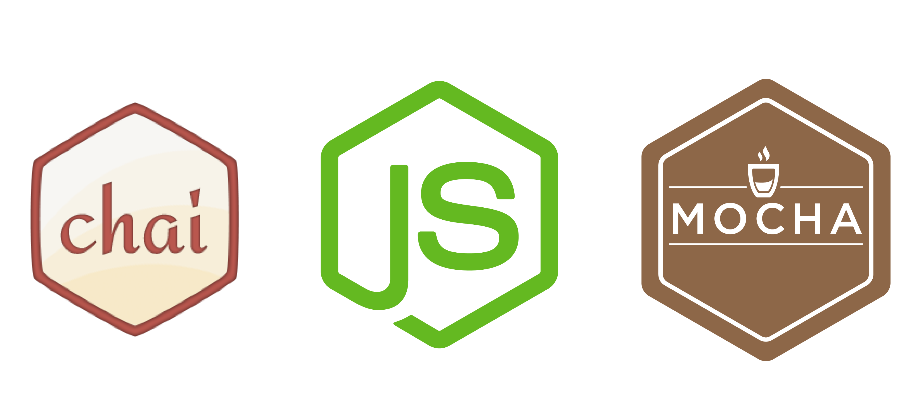
Introduction to Mocha and Chai
Mocha and Chai in Cypress
Cypress integrates Mocha and Chai seamlessly, combining test structuring (Mocha) and clear assertions (Chai).
Simplifies test creation, enhances readability, and improves debugging through meaningful error messages.
Why Use Mocha and Chai ?
Clear Organization: Mocha's structured test definitions improve clarity.
Readable Assertions: Chai’s expressive syntax helps teams understand tests faster.
Ease of Use: Ideal for both beginners and experienced testers, simplifying collaboration between developers and testers.
Support for BDD and TDD: Facilitates Behavior-Driven Development and Test-Driven Development practices, encouraging better design and fewer bugs.
Asynchronous Testing Capabilities: Effectively handles asynchronous operations, which is crucial for modern web applications.
Notes:
Let’s Understanding Test Runner Interface
Cypress Test Runner is a GUI for visualizing and debugging tests. It features a dashboard listing tests, a test runner window showing commands and results, and a browser window displaying the application being tested.
Besides running tests, it includes tools for debugging and troubleshooting, such as a console for logging messages and interacting with the application in real-time, and a network tab for monitoring HTTP requests and responses.
By providing real-time insights into the application's behavior and execution process, it helps QA and developers promptly identify and resolve issues. The interactive interface allows interaction with the application under test and validation of test results.
Key Features of Cypress Test Runner
The Cypress test runner provides a number of features that make it an ideal choice for end-to-end testing.
Interactive Test Execution: Cypress test runner provides a graphical interface that allows you to interact with tests in real time. This means that you can see the application being tested and interact with it while the test is running.
Debugging: Cypress test runner allows you to set breakpoints, pause and inspect code during test execution. This makes it easier to identify and fix issues in the code.
Time Travel: Cypress test runner provides a time-travel feature that allows you to go back and forth between the different states of the application being tested. This makes it easier to debug and understand the behavior of the application.
Rerun Test: You can rerun the Cypress test directly from the Test Runner screen, which reduces the amount of time, going back to IDE and starting the test execution.
Real-Time Feedback: Cypress test runner provides real-time feedback on test results, which allows you to quickly identify issues and fix them.

Slide 6
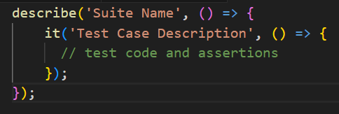
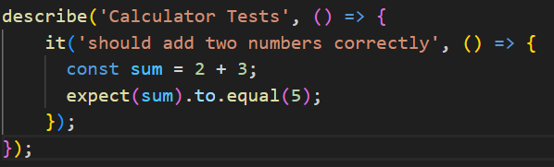
Writing Basic Test Cases using describe, it
Structure of a Basic Test
describe: Defines a test suite or a group of related tests.
it: Defines an individual test case within a suite.
Syntax
Example 1: Writing Basic Tests
Notes:
Let’s Understanding Test Runner Interface
Cypress Test Runner is a GUI for visualizing and debugging tests. It features a dashboard listing tests, a test runner window showing commands and results, and a browser window displaying the application being tested.
Besides running tests, it includes tools for debugging and troubleshooting, such as a console for logging messages and interacting with the application in real-time, and a network tab for monitoring HTTP requests and responses.
By providing real-time insights into the application's behavior and execution process, it helps QA and developers promptly identify and resolve issues. The interactive interface allows interaction with the application under test and validation of test results.
Key Features of Cypress Test Runner
The Cypress test runner provides a number of features that make it an ideal choice for end-to-end testing.
Interactive Test Execution: Cypress test runner provides a graphical interface that allows you to interact with tests in real time. This means that you can see the application being tested and interact with it while the test is running.
Debugging: Cypress test runner allows you to set breakpoints, pause and inspect code during test execution. This makes it easier to identify and fix issues in the code.
Time Travel: Cypress test runner provides a time-travel feature that allows you to go back and forth between the different states of the application being tested. This makes it easier to debug and understand the behavior of the application.
Rerun Test: You can rerun the Cypress test directly from the Test Runner screen, which reduces the amount of time, going back to IDE and starting the test execution.
Real-Time Feedback: Cypress test runner provides real-time feedback on test results, which allows you to quickly identify issues and fix them.

Slide 7
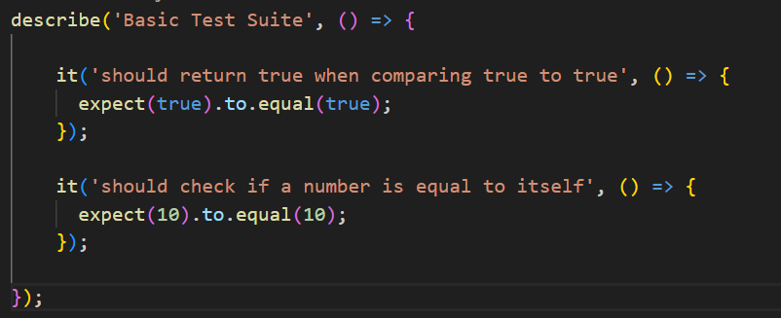
Writing Basic Test Cases using describe, it
Example 2: Very Basic Test Example
Best Practices:
Keep test cases concise and focused on a single functionality.
Use descriptive names for suites (describe) and test cases (it) to clearly convey test purposes.
Utilize assertions effectively to verify expected behaviors and outcomes.
Notes:
Let’s Understanding Test Runner Interface
Cypress Test Runner is a GUI for visualizing and debugging tests. It features a dashboard listing tests, a test runner window showing commands and results, and a browser window displaying the application being tested.
Besides running tests, it includes tools for debugging and troubleshooting, such as a console for logging messages and interacting with the application in real-time, and a network tab for monitoring HTTP requests and responses.
By providing real-time insights into the application's behavior and execution process, it helps QA and developers promptly identify and resolve issues. The interactive interface allows interaction with the application under test and validation of test results.
Key Features of Cypress Test Runner
The Cypress test runner provides a number of features that make it an ideal choice for end-to-end testing.
Interactive Test Execution: Cypress test runner provides a graphical interface that allows you to interact with tests in real time. This means that you can see the application being tested and interact with it while the test is running.
Debugging: Cypress test runner allows you to set breakpoints, pause and inspect code during test execution. This makes it easier to identify and fix issues in the code.
Time Travel: Cypress test runner provides a time-travel feature that allows you to go back and forth between the different states of the application being tested. This makes it easier to debug and understand the behavior of the application.
Rerun Test: You can rerun the Cypress test directly from the Test Runner screen, which reduces the amount of time, going back to IDE and starting the test execution.
Real-Time Feedback: Cypress test runner provides real-time feedback on test results, which allows you to quickly identify issues and fix them.

Slide 8

QUIZE
Question | A | B | C | D | Answer
What is Mocha primarily used for? | Styling webpages | Database management | Writing and organizing JavaScript tests | Deploying applications | C
Which term refers to a single test case in Mocha? | describe | it | test | expect | B
Why are hooks like beforeEach and afterEach used? | To style tests | To define assertions | To perform setup and cleanup actions | To organize test descriptions | C
Which assertion styles in Chai are easy to read and natural? | expect and should | assert and test | describe and it | before and after | A
Mocha and Chai are primarily useful because they: | Improve database performance | Enhance website styling | Make JavaScript testing structured and clear | Help deploy applications faster | C
8
© 2025 Cognizant | Private
Notes:
Lets try to find answer for the quizzes

Slide 9
Topics covered in the session Introduction to Mocha and Chai Writing Basic Test Cases using describe, it
Thank you!

